Slide 1


Feasibility
Sight Read percussion:
As much as you want
the Exact way you want
Team Copper
Old Dominion University CS 410
Fall 2023
Team Copper Fall 2023
Notes:
Hello, we’re Team Copper, and this is our CS410 project: Percuss At Sight, a sight reading tool for percussion instrument players

Slide 2

Table of Contents
Team Copper
Background Information
Problem
Solution
MFCD
Scope
Market/Competition
Risks
Conclusion
Table of Contents (What we will tell the audience) (1 slide)
Image Source: https://thumbs.dreamstime.com/b/marimba-mallets-11029633.jpg
Team Copper Fall 2023

Slide 3





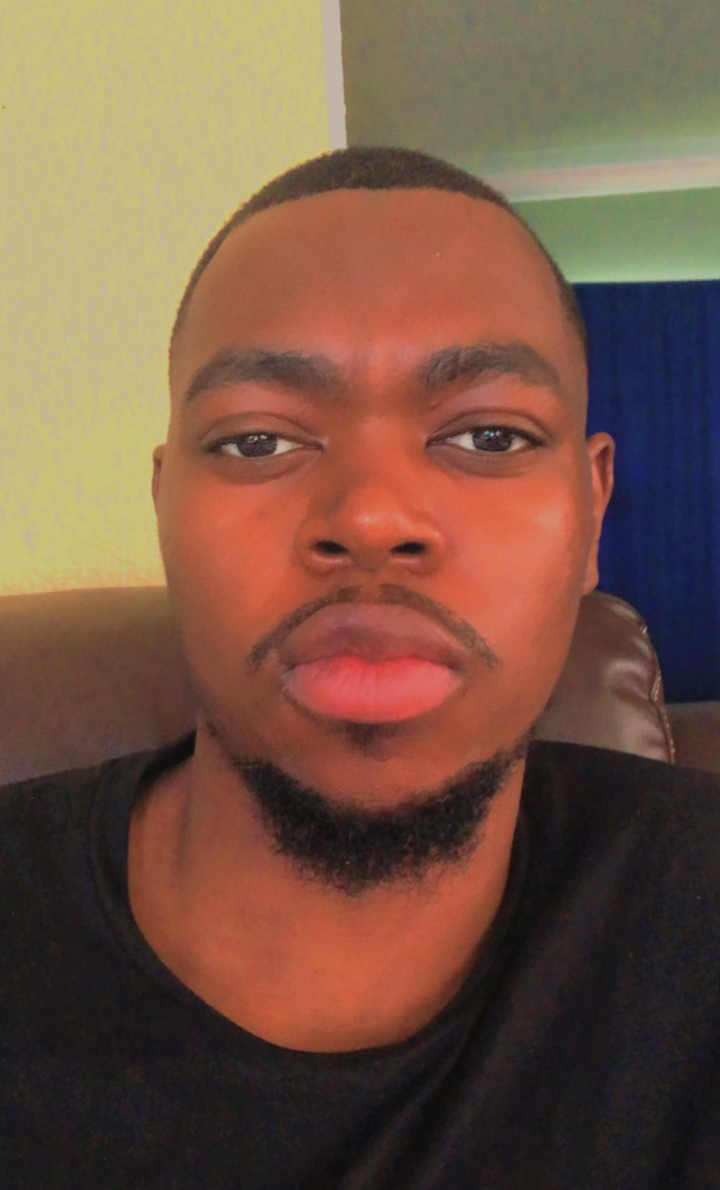

Team Copper
Deven Bhaggan
Website Lead
Deven is a senior at ODU majoring in computer science. He is from Northern Virginia and works as a basketball trainer and coach. In his free time, he loves going to the gym and playing video games.
Jeremy Sloan
Project Lead
Jeremy is a senior at ODU majoring in Computer Science and Music. He’s from Norfolk, Virginia and loves sports and video games.
Phat Nguyen
Back-End Specialist
Phat is a senior at ODU majoring in computer science. He is from Hampton, Virginia and works part time as a student worker for root@cs.odu.edu. As of now he enjoys listening to a variety of music, playing video games, and doing calisthenics.
Chris Maguschak
Front-End Specialist
Chris is a super-senior at ODU pursuing his bachelor's in computer science. He's from Norfolk, Virginia and works as a full time student. He enjoys programming, video games, and rock climbing
Simeon Wafula
Documentation Specialist
Simeon is a senior at ODU majoring in computer science. He lives in Suffolk, Virginia and in his free time he enjoys reading, playing and watching sports, especially soccer and basketball.
Ismail Ismail
Database Specialist
Ismail is a senior at ODU majoring in computer science. He is from Washington, DC and works full time. He loves to play soccer and spend time with family.
Team Copper Fall 2023
Notes:
Everyone introduce yourself. You know yourself better than I know you, so just rehearse your intro before presenting

Slide 4

What is Sight Reading?
Sight reading is the act of reading and playing a piece of music without any prior rehearsal or practice. It is a highly valuable skill for musicians, as it allows them to quickly interpret and perform new compositions.
If mastered, sight reading can be very beneficial as it allows musicians to quickly adapt to new musical material and save time in rehearsals and practice sessions.
Team Copper Fall 2023
Notes:
So, what is sight reading? Well, simply put, it’s the ability to read sheet music. Much like how, when you read the word “cat”, you don’t read “c-a-t”, you read a pattern of syllables you say in your head, when reading sheet music, experienced musicians are supposed to see a pattern that your brain can interpret as sounds. It’s a difficult but useful skill, and it takes time to master. However,

Slide 5


Sight Reading: A Crucial Skill for Musicians
Sight Reading is Crucial for:
Finding jobs
Collaborating with Musicians⁽¹⁰⁾
Building musicianship⁽¹²⁾
Solidifying music understanding⁽¹²⁾
Providing a significant step ahead in Auditions⁽¹¹⁾
Deeply learning one’s instrument ⁽¹⁾
Preparing for music and academic examinations⁽²⁾
Research shows that students who practiced sight reading regularly scored significantly higher in performance assessments⁽⁴⁾
Studies point to sight reading being extremely imperative for performers as it’s being focused the most by judges in auditions⁽¹¹⁾
Data analytics and survey-based studies strongly suggest that Sight Reading is essential for the professional growth of music teachers, providing an important pedagogical skills and abilities as well as promoting self-confidence, creativity and improvisation⁽¹⁾

Slide 6
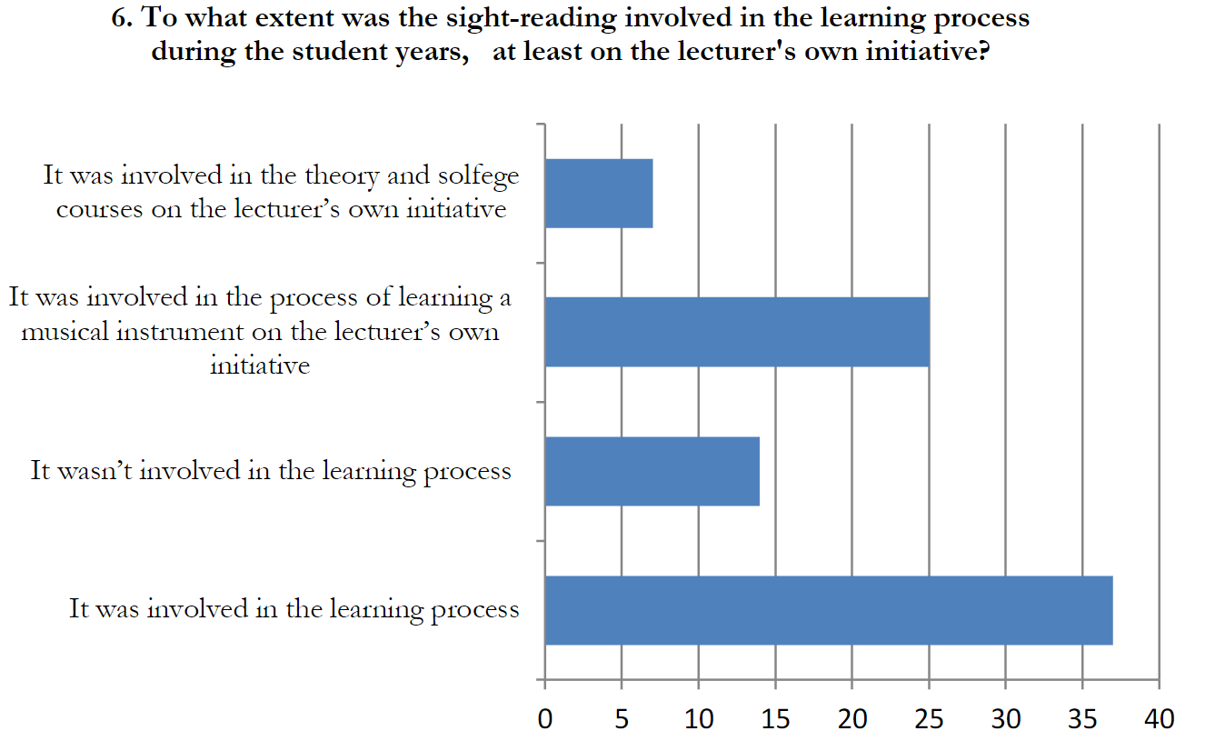
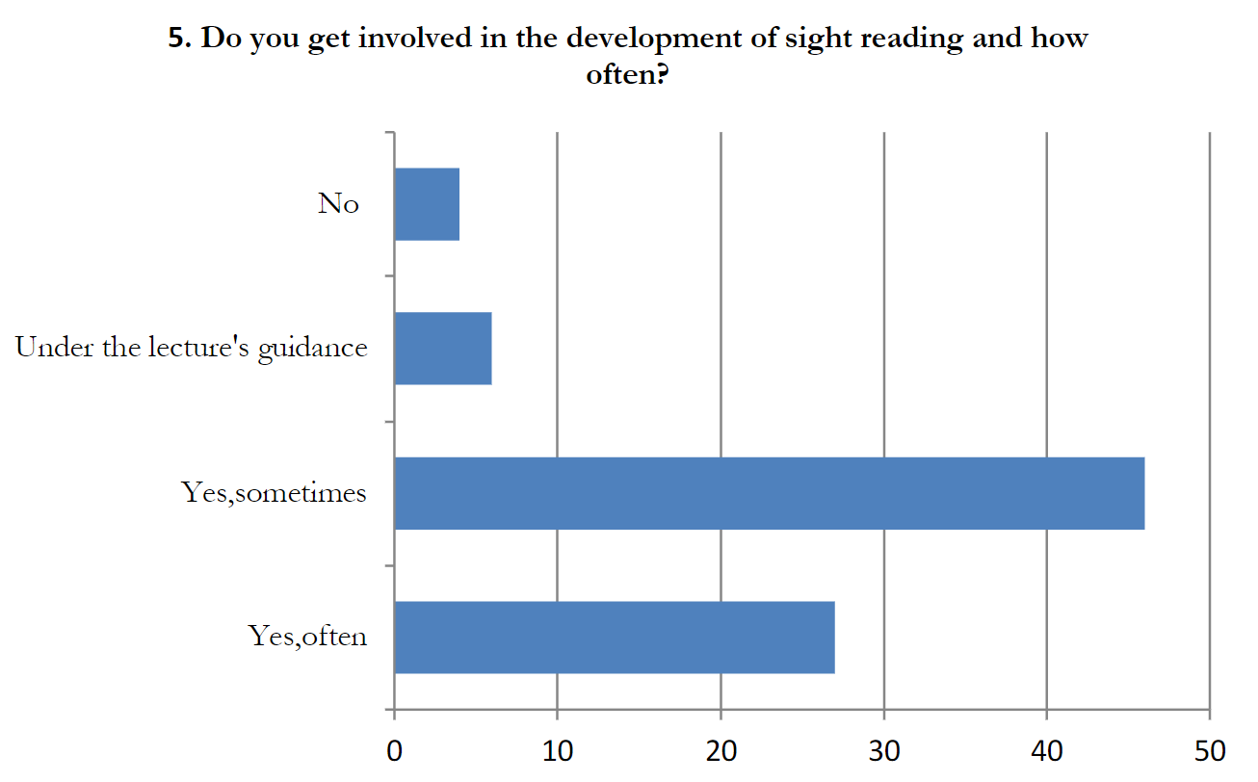
The Importance of Sight Reading to Musicians
Sight Reading is also a skill that musicians use very often⁽¹⁾
- Surveyed Musicians
Sight Reading plays very important role to a lot of musicians when learning their instruments⁽¹⁾
- Surveyed Musicians
Image Source: https://odu-primo.hosted.exlibrisgroup.com/permalink/f/1ucqpjv/TN_cdi_doaj_primary_oai_doaj_org_article_a52cc11ee5184a8a9809abcb93ae5b51

Slide 7
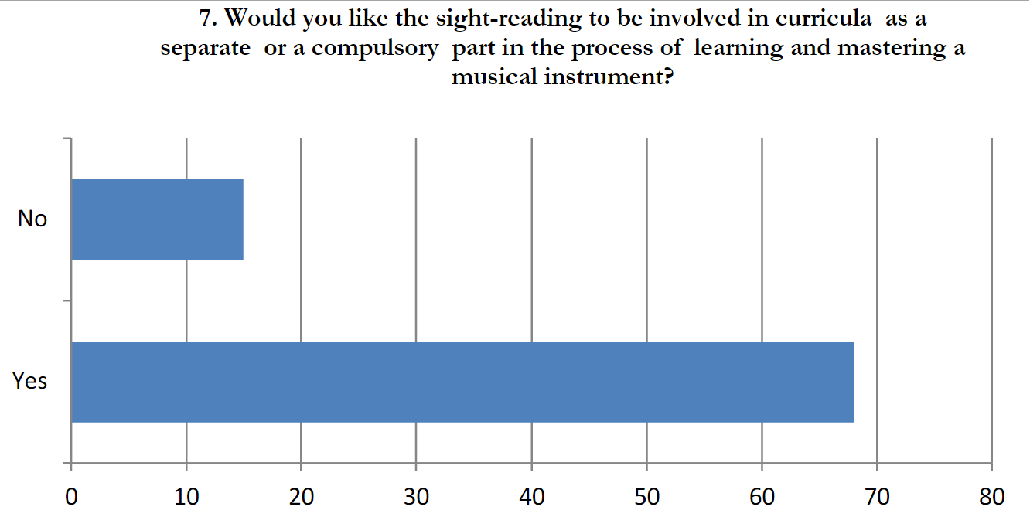
The Importance of Sight Reading to Teachers and their Students
Music Teachers
Need an infinite resource to point students to in order to help them
lack a tool that can especially isolate certain elements to one or two things
Students
Students want to be taught this skill ⁽¹⁾
However teacher’s lack a tool to help teach them
- Surveyed Musicians
Image Source: https://odu-primo.hosted.exlibrisgroup.com/permalink/f/1ucqpjv/TN_cdi_doaj_primary_oai_doaj_org_article_a52cc11ee5184a8a9809abcb93ae5b51

Slide 8
Sight Reading Apps: a Digital shift in Music Education
Teachers and Music Performers are increasingly integrating Sight Reading Apps in their practice. Musical examination boards are increasingly relying on technology, especially, sight reading apps as useful resources for students []
In the last two months, the traffic of general sight reading apps are have nearly doubled, with these apps currently getting about 197,800 monthly visits REPHRASE THIS LATER ⁽⁵⁾

Slide 9

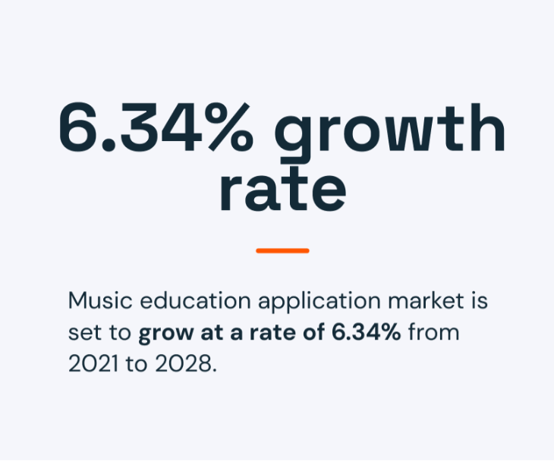

Sight Reading Software and The Future of its Market
According to the Global Market Search report, the market size for music education was valued at approximately $93.85 billion in 2019. ⁽¹³⁾
The app market for music education is on the rise and will continue to be as people are investing more and more

Slide 10
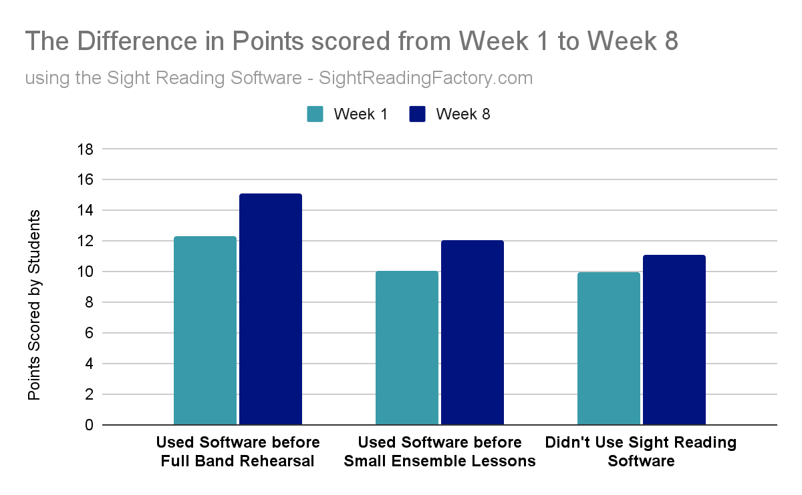
The Effectiveness of Sight Reading Software for Teaching and Learning
Teachers and their Students in this space will drastically benefit from using PercussAtSight over time
Studies show that the use of a general sight reading app before Band rehearsal, severely helped High School Students’ sight reading within a span of 8 weeks⁽⁴⁾
Team Copper Fall 2023
Source of Data: https://odu-primo.hosted.exlibrisgroup.com/permalink/f/1ucqpjv/TN_cdi_ingenta_journals_ic_intellect_17527066_v11n2_20210721_1415_default_tar_gz_s2

Slide 11
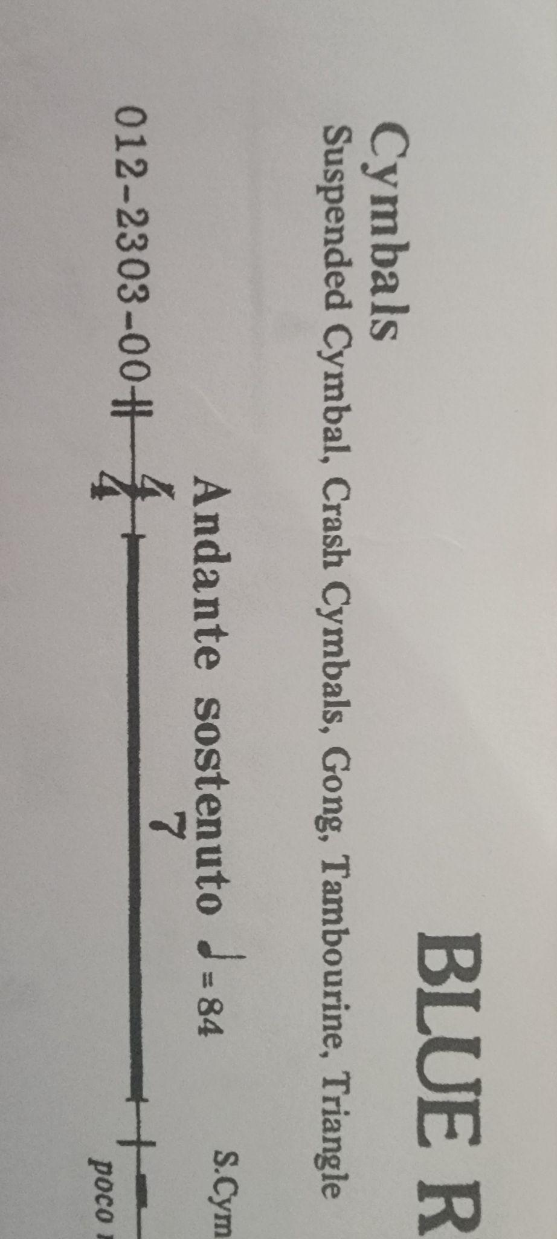

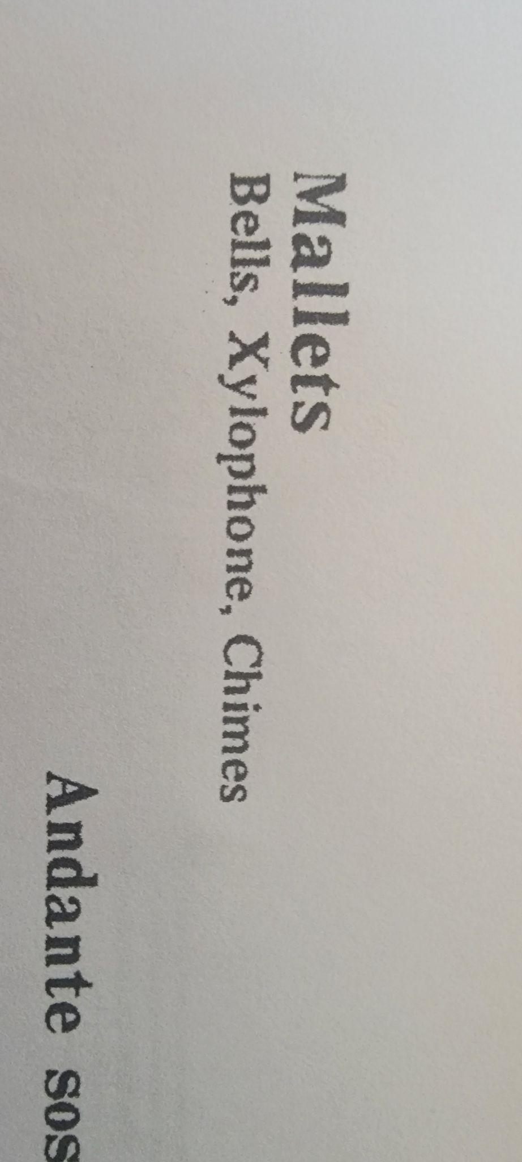
Why Percussionists’ Unique Needs are being Excluded from Current apps
Notation varying between instruments
For certain instruments, Notation symbols can change between scores
Makes notation confusing
This variance should be included in apps but aren’t
Why do apps exclude this?
Their instrument is excluded from a app
Have a hard time, finding their in current apps for sight reading practice
Why do apps exclude these instruments?
Instrument Switching
Percussion scores require several instruments to cover
A lot of times leads to one percussionist covering several instruments
As a result, Multiple instruments are switched between or sometime played simultaneously
Why is this excluded from apps?

Slide 12



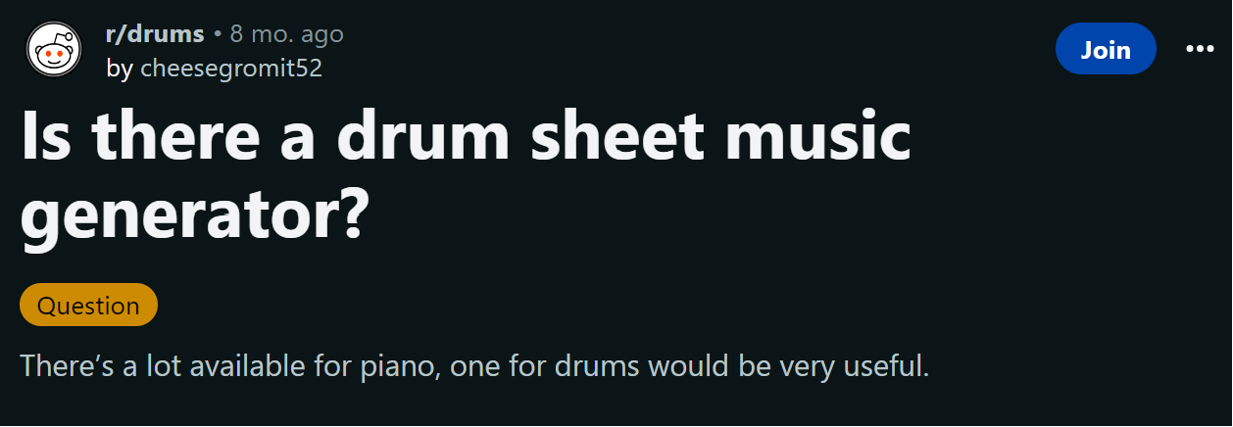
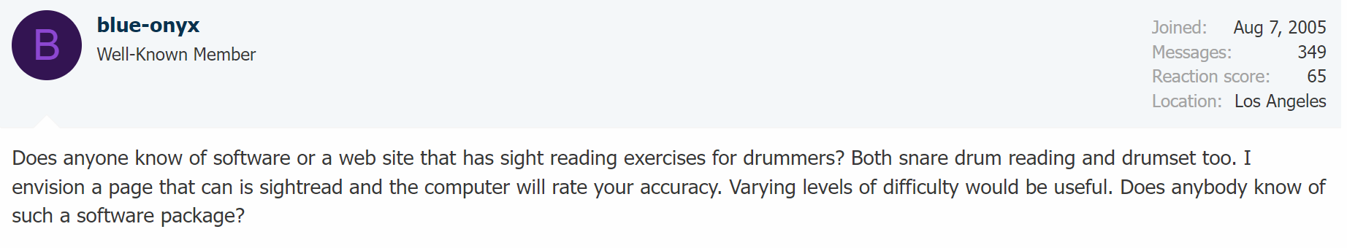
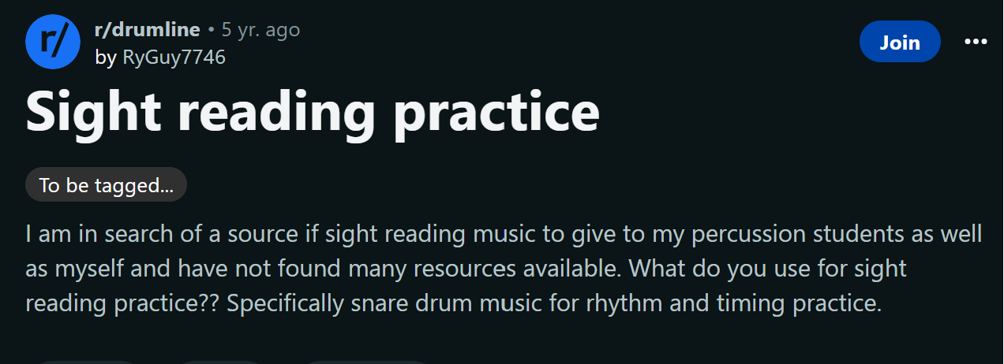
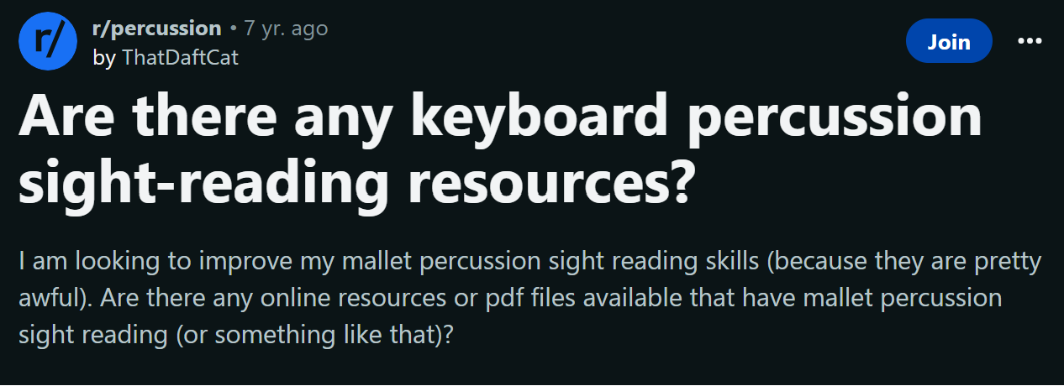

Percussionists Express the Need for a Sight Reading Resource
The need for dedicated Sight Reading resources is widely expressed in Percussionists’ online communities and social media platforms
Team Copper Fall 2023
Image source: https://i1.pickpik.com/photos/381/267/826/technology-computer-technology-preview.jpg

Slide 13
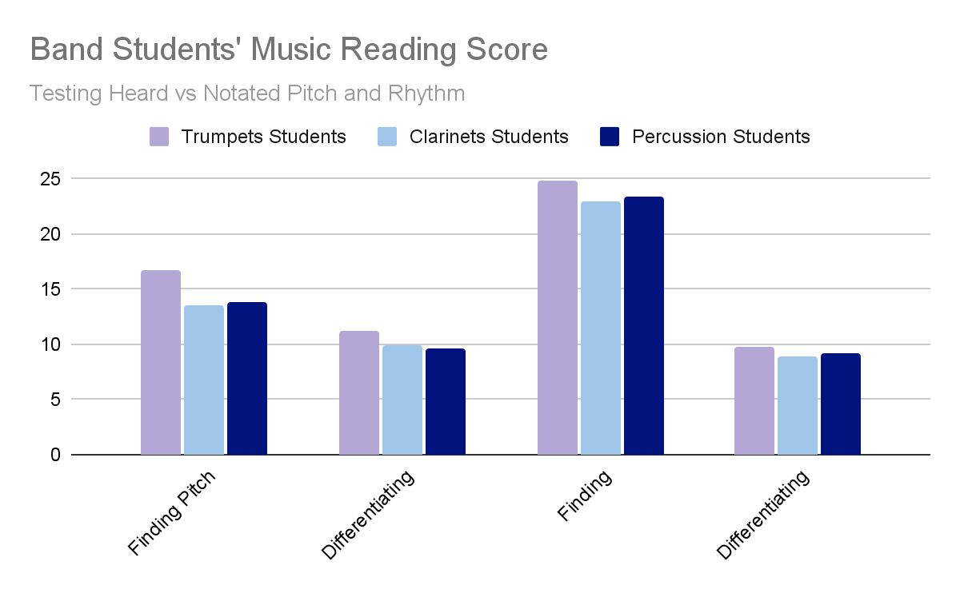
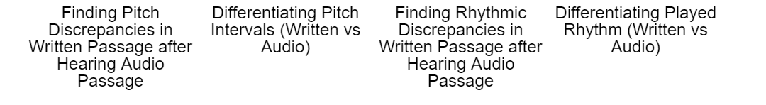
Percussionists’ Musical Reading Levels are Inferior
Percussionists struggle with low reading levels
Especially true in High School Orchestras/Bands
Out of selected North Carolina schools, percussionists tested lower in their music reading level compared to their other band/orchestra counterparts.⁽⁴⁾
This lower proficiency level can severely affect their Sight Reading capabilities
If a percussionist struggles with reading in general, they stand no chance reading at first sight
Percussionists need a tool that they can repeatedly use to improve their music reading which will in correlation help their sight reading
Team Copper Fall 2023
Source of Data: https://libres.uncg.edu/ir/uncg/f/Wheeler_uncg_9303961.pdf

Slide 14
Who is Suffering from this Problem?
Teachers who need
a tool that helps teach their students how to Sight Read
a Sight Reading resource that won’t run out
Students that
are without a resource they can apply what they’ve learned
Percussionist who
have instruments that are excluded in current solutions
suffer from a low music literacy level
express online a tool to improve their Sight Reading
Team Copper Fall 2023

Slide 15

Problem Statement
Percussionists face a distinctive set of challenges with their instruments, yet they currently lack a specialized sight-reading application meticulously crafted to address their specific needs. This absence significantly impedes their ability to adequately prepare for auditions, engage in effective daily practice, deliver impactful teaching sessions, and overall, hinder their progress in honing their musical skills.
Team Copper Fall 2023

Slide 16
Problem Characteristics
Inefficient Teaching:
Lack a resource to help isolate certain musical concepts (scales, rudiments, arpeggios, etc.) making it harder to teach sight reading
Costly Resources:
Purchasing various books for diverse percussion instruments can be expensive.
Available books often lack an organized and effective structure for progressive sight-reading practice. Moreover, percussionists frequently encounter pieces in these books that are either too easy or excessively challenging making it difficult to consistently find material that matches their skill level.
Limited Resources:
Repeatedly having to sight read different sheet music is important to improve this skill
No matter how helpful they are, books are a resource that will eventually run out
Auditions:
Some ensembles (group of musicians) require an adequate enough level of sight reading
Resources are very scarce online, leaving percussionists in a difficult spot
Team Copper Fall 2023

Slide 17
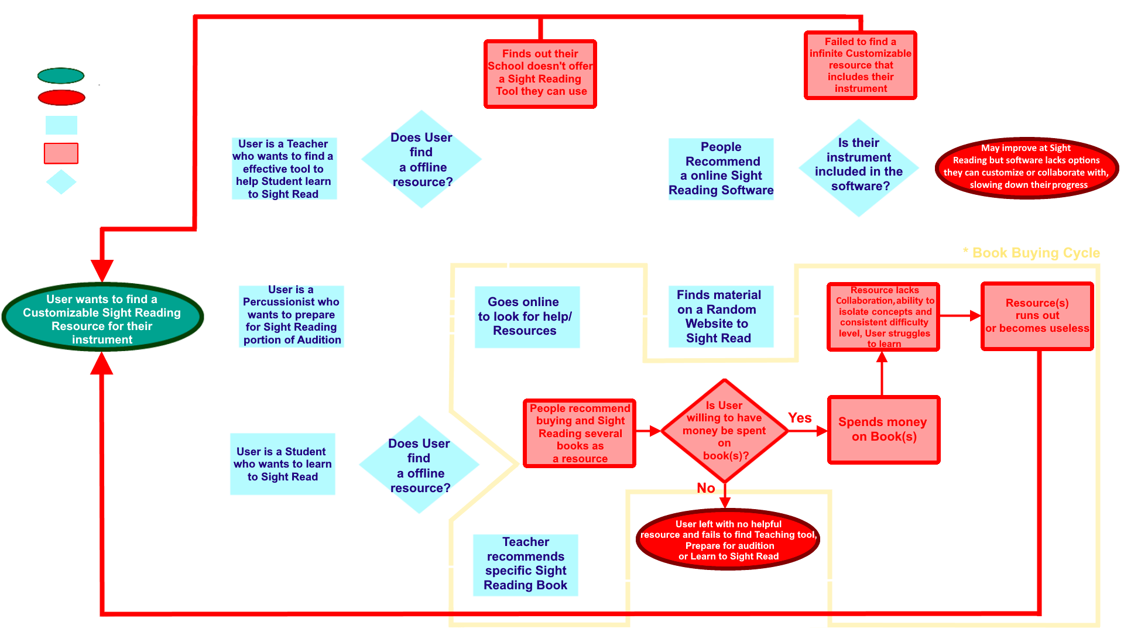
Current Process Flow
^And Here

Slide 18
Solution Statement
PercussAtSight stands as an innovative sight-reading coach designed to revolutionize percussionists’ practice routines. Offering an expansive, adaptable, and interactive reservoir of sight-reading content. PercussAtSight caters specifically to the distinct requirements of percussion musicians. In contrast to conventional, limited practice materials, PercussAtSight dynamically generates percussion scores and drum charts, ensuring musicians remain engrossed, continually challenged, and well-prepared. Harnessing cutting-edge software capabilities, this platform emerges as an unrivaled asset for percussionists, educators, and students across all proficiency levels.
Team Copper Fall 2023

Slide 19
Solution Characteristics
Teaching tool - Aimed at providing a resource for teachers, students, and individuals
Unlimited Resource - Infinite Sheet Generation
Randomized
Include multiple instruments
AI-driven adjustments
Collaborative Learning
Instructor feedback
Peer learning - might get rid of as its hard to explain and properly implement or think of as competition among peers.
Topic isolation
Cost Efficient
Subscription Based
Education based subscription
Individual based subscription
More affordable than books - unlimited resources for the same price
Team Copper Fall 2023
Notes:
Elaborate more while presenting
Percuss at sight is a tool that will help percussionists with their sight reading skills
Percuss at sight does by providing the following features
Provides a teaching tool - better than books, app is more dynamic
Sheet generation - provides an infinite number, and variety of sheet music
Collaborative or Adaptive learning - (might include in other section)
Instructors may give input on student progress and influence sheets
Students can practice with other students?
Topics can be isolated for increased learning opportunities
Go over different scenarios, student-teacher, individual, etc
Cost efficient
Subscription based - Use two separate subscriptions, one for schools, one for individuals
More cost effective than books, multiple books needs to be purchased in order to achieve a wider variety of practice
Go over different scenarios, education, school, individual

Slide 20
Solution Characteristics (cont’d.)
User Customization
Provides customized practice environment for users
Auditions - Application can generate more difficult practice sheets
General Practice
Changes in difficulty
AI adaptability - AI can view performance and make adjustments based on performance
Instrument Catalog
Variety of Percussive Instruments
Catalog included in sheets
Team Copper Fall 2023
Notes:
Potentially elaborate during the presentation
User Customization
Provides user with a learning environment - catered to that user, potentially done through AI
Go over different user cases/scenarios and show how the environment can be customized toward the user
Audition - generate more complex scores?
Practice - playback feature for compare performance?
Changes in difficulty, user can adjust difficulty of sheets, scores, and charts
Real-time feedback, show user how well they did, potentially powered by AI
Changes pitch, tone, adjust to certain types of instruments sound.
AI adaptability
Stated above, AI may be able to help the user in providing an environment best suited for them, and provides real-time feedback?
Real-time feedback - app will analyze input given by user with the generate score
Instrument Catalog - inclusive instrument catalog of percussive instruments
Percuss at sight will house a wide variety of percussive instruments for users to practice on.
Go into detail the types of instruments offered, and their potentially differences (pitch?, tone?, depth?)
Said instruments can be included in generation of sheets, given user input
Discuss how this ties back into sheet generation, and that the sheets can integrate multiple instruments (potentially)

Slide 21
Problem and Solution
Problem
Inefficient Teaching Tools
Limited Resources
Cost Ineffective
Auditions
Solution
Teaching Tool
Unlimited Resource Generation
Cost Effective
Customizable

Slide 22
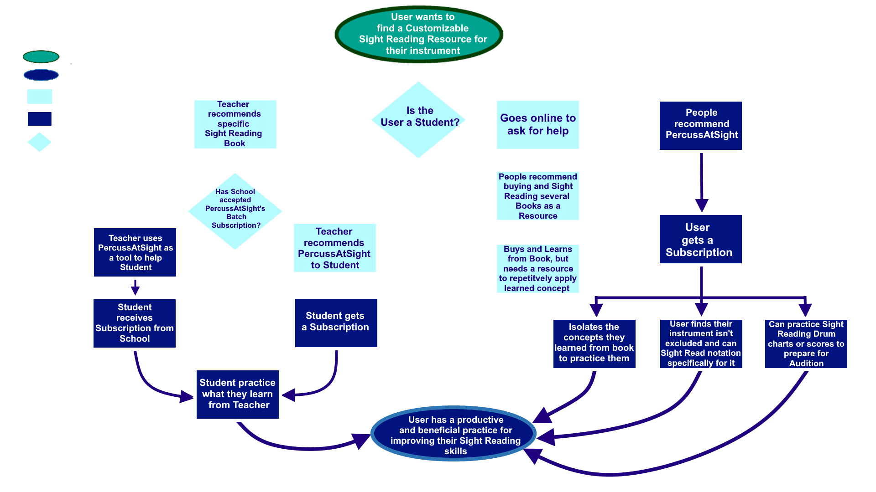
Solution Process Flow
Team Copper Fall 2023

Slide 23
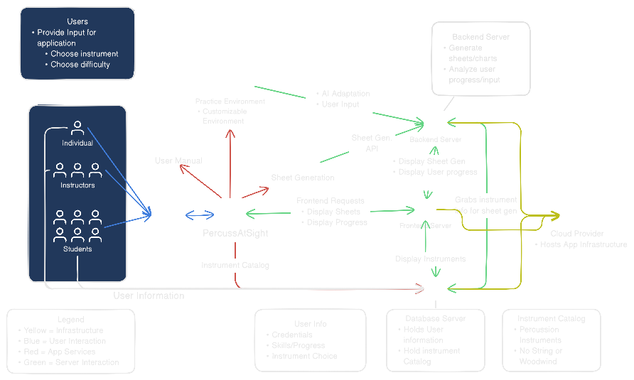
Major Functional Components Diagram (MFCD)
Team Copper Fall 2023
Notes:
Remove Devices, Remove aspects of internal infrastructure
Application
Front end - display UI, display the sheets generated and what instruments are used by the sheets
Sheet generation - api? Handled by backend server? Api sends requests to backend server or api generates them?
Instrument catalog - housed on the database server - backend server interacts with database server to help get instrument information to generate sheets
User Information - Housed on the database server
User guide - gives the user a general overview on how to use the app
Internet - App receives updates from internet
Application server - internal infra, cloud infra?

Slide 24
What will the project not do?
Support Other types of Instruments
Woodwind
String
Will not do the learning for the user
Team Copper Fall 2023
Notes:
PercussAtSight will not support instruments other than percussion? (I would say this holds up since the app is catered toward percussionist)
App will not do the learning for the user

Slide 25
Market Assessment
PercussAtSight's focus on addressing percussionists' unique needs. We have a niche focus that provides cost savings as well as education and audition preparation for academic institutions and individual learners alike. Our main competition will be existing music education apps as well as traditional sheet music and books. But, our app’s specialization in percussion could give it an edge in terms of relevance and specific features. Success will depend on effective marketing, continuous improvement, and our ability to attract a dedicated user base within the percussion community.
Team Copper Fall 2023

Slide 26
Competition Matrix
 | Percuss At Sight | North London Drums | Sight Reading Factory | Drumeo | Drums Sheet Reading | Snare Drill | Rhythm Sight Reading Trainer | Rhythm Trainer
Random Score Generating | ✓ | ✓ | ✓ |  |  | ✓ |  | ✓
Infinite Supply of Scores | ✓ | ✓ | ✓ |  |  | ✓
Various Difficulty Levels | ✓ | ✓ | ✓ | ✓ | ✓ |  | ✓ | ✓
Abundant Percussion Instrument Selection | ✓
Infinite Supply of Drum Charts | ✓ | ✓
Combine Instruments Together | ✓
Isolate Concepts | ✓ |  |  | ✓ | ✓ |  | ✓ | ✓
Different Musical Styles | ✓ | ✓ |  | ✓ | ✓
Progress Tracking | ✓ | ? | ✓ | ? | ??? | ??? | ???

Slide 27
User and Technical Risks
5
4
3 |  | R1 | R4 |  | R2
2 |  | R3, M4 |  | M2
1 | M1, M3
 | 1 | 2 | 3 | 4 | 5
User:
R1: User’s instrument isn’t included in App’s selection.
M1:App will have a “Request to Include my Instrument” button to notify developing team.
R2:User loses motivation to use App.
M2: Implement personalized practice plans feature. Send regular practice notifications to keep users engaged.
Technical:
R3: Risk: User has no internet connection.
M3: Offer online version of app.
R4:Code needs to be maintained for bugs and updates.
M4: Set a team for scheduled manual updates.
Likelihood
Severity
Team Copper Fall 2023

Slide 28
Legal Risks
R1: A randomly generated notation has a melody, beat or chord sequence that resembles a known/existing song or sheet music piece.
M1: Include disclaimer in app stating that any resemblance is purely coincidental.
R2: User data and privacy needs protection.
M2: Comply with data protection regulation (ex. General Data Protection Regulation - GDPR)
R3:Playback features requires third party percussion sounds.
M: Have third party contract with a music sound supplier to use their percussion sounds in our playback feature.
5
4
3
2 | R2 R3
1 | M1, M2, M3 |  | R1
 | 1 | 2 | 3 | 4 | 5
Likelihood
Severity

Slide 29
School Risks
R1: School’s given student count increases mid-semester/school year, exceeding the subscription amount that was paid for.
M1: Schools can contact us to request additional subscriptions with school discount still applied.
R2: Renewal period approaches with some school’s student never using their paid subscriptions.
M2: Include a disclaimer stating that the subscriptions can roll over to the next school year, until they’re used.
R3: School has no subscription service but a teacher recommends our software to a student
M3: Student can use “Request my School” button to have us add their school.
5 |  | R2
4
3 |  |  | R3 | R1
2 | M2 |  | M1
1 |  | M3
 | 1 | 2 | 3 | 4 | 5
Likelihood
Severity

Slide 30
Security Risks
5
4 |  |  | R1
3
2 |  | M3 |  | R3
1 | M1, M2 |  |  |  | R2
 | 1 | 2 | 3 | 4 | 5
R1: The School Code gets leaked to people not part of that school.
M1: We’ll create a customized student extension to the school code and have the school designate the unique codes to each student’s name in their roster.
R2: Username and passwords get leaked.
M2: Two factor authentication can be implemented as an added security feature, encrypted data protocol.
R3: Data breaches occurring due to lack of security.
M3: Conducting standard cyber security practices.
Likelihood
Severity

Slide 31
Key Points
PercussAtSight is a meticulously crafted sight reading application aimed at solving the challenges percussionists face with their instruments. It is a specialized application that will augment percussionist abilities in a variety of ways that include:
- As a teaching tool for teachers, students, and individuals through the generation of an infinite and
randomized number of sheet music, inclusion of multiple instruments and smart adjustments.
- Collaborative Learning by including instructor input, peer learning and topic isolation.
- Cost efficient compared to books and offers education and individual based subscription
programs
- Allowing for user customization by providing a personalized environment for users, AI adaptability
And changes in difficulty.
- An instrument catalog containing various percussive instruments and the catalog included in the
sheets.
Team Copper Fall 2023

Slide 32
References/Citations
1. Adamya, Anna. Sight-reading as an important factor in the professional growth of future music teacher, Vortex Music Journal, 15 Sept. 2020, pp. 10-12. https://odu-primo.hosted.exlibrisgroup.com/permalink/f/1ucqpjv/TN_cdi_doaj_primary_oai_doaj_org_article_a52cc11ee5184a8a9809abcb93ae5b51
2. “Before Your Remote Practical Exam.” The Royal Conservatory, 2023, https://www.rcmusic.com/learning/examinations/remote-exams/remote-practical-exams/before-your-remote-practical-exam
3. Bovin, Amy J., The effects of frequent use of a web-based sight-reading software on eighth graders’ music notational literacy, Journal of Music, Technology & Education, 2018, pp. 139 - 140. https://odu-primo.hosted.exlibrisgroup.com/permalink/f/1ucqpjv/TN_cdi_ingenta_journals_ic_intellect_17527066_v11n2_20210721_1415_default_tar_gz_s2
4. Wheeler, Mark R., A Comparative Analysis of Melodic and Rhythmic Music Reading Skills of Percussion and Wind Instruments Students in Selected North Carolina High Schools, 1992, pp. 36. https://libres.uncg.edu/ir/uncg/f/Wheeler_uncg_9303961.pdf
5. Sight Reading Factory, sightreadingfactory.com, Accessed 7 Oct. 2023.
6. North London Drums, https://northlondondrums.co.uk, Accessed 8 Oct. 2023.
7.”Marimba Mallets.” dreamstime.com,, https://thumbs.dreamstime.com/b/marimba-mallets-11029633.jpg.
8. “Technology Computer Technology Preview”, pickpik.com, https://i1.pickpik.com/photos/381/267/826/technology-computer-technology-preview.jpg.
9. Li, Sunny. “Piano sight-reading for beginners.”, pianistmagazine.com, 23 Sept. 2019, https://www.pianistmagazine.com/blogs/piano-sight-reading-for-beginners/.
10. “The Benefits of Sight-Reading: The What, Why, and How “, makemusic.com, 3 Oct. 2023, https://www.makemusic.com/blog/the-benefits-of-sight-reading-the-what-why-and-how/.
11. Wine, Thomas R., All-State Choruses: A Survey of Practices, Procedures, and Perceptions, The Choral Journal, Mar. 1996, pp. 26. https://odu-primo.hosted.exlibrisgroup.com/permalink/f/1ucqpjv/TN_cdi_proquest_journals_1306224962
12. Zhang, Diana J. et al. Aspects of Musical Performance That Are Most Highly Related to Musical Sophistication,Psychomusiology: Music, Mind and Brain, 2020, pp 67. https://odu-primo.hosted.exlibrisgroup.com/permalink/f/1ucqpjv/TN_cdi_proquest_journals_2594716298
13. “Essential Music Education Market Size Statistics in 2023.” Zippo, 16 Jul. 2023, https://zipdo.co/statistics/music-education-market-size/.
Team Copper Fall 2023

